Slide 1
Low Power System Design (PVL 207)

Slide 2
Minimizing switched capacitance
Switched capacitance minimization techniques:
Hardware software trade-off
Bus encoding
Clock gating
FSM
Gated FSM
State encoding
FSM Partitioning
Operand Isolation
Precomputation
Use of number systems
Architecture level optimizations
Logic Styles

Slide 3

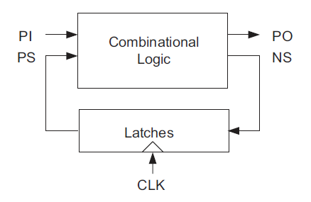
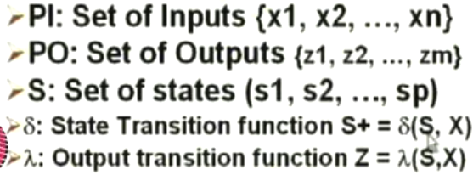
FSM
Inputs (PI) and outputs (NS) are applied in each cycle

Slide 4
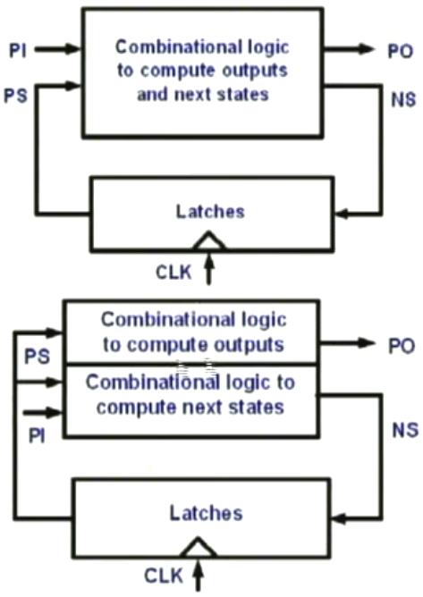
FSM
Inputs (PI) and outputs (NS) are applied in each cycle

Slide 5
Clock Gated FSM
There are conditions when the next state and output values do not change (idle condition)
Clocking the circuit during idle condition leads to unnecessary wastage of power.
The clock can be stopped, if idle condition can be detected.
This saves power both in combinational circuit as well as the registers/latches.

Slide 6
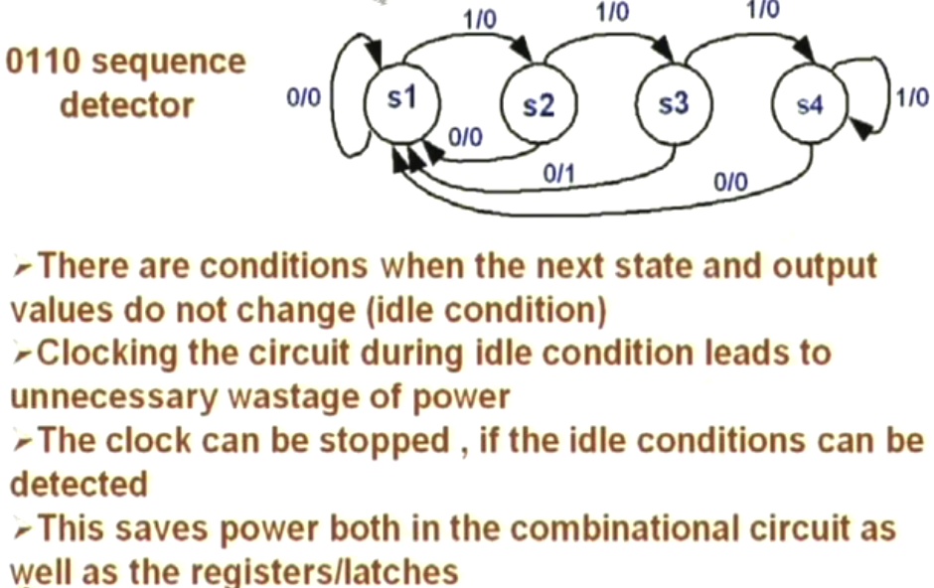
Clock Gated FSM

Slide 7
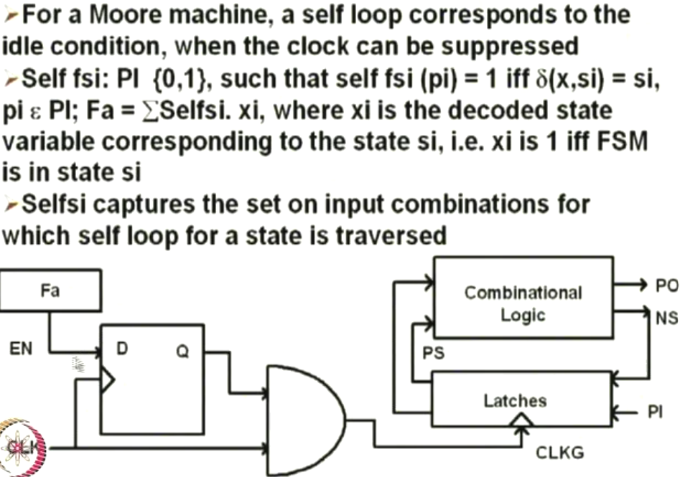
Clock Gated FSM
CLK

Slide 8
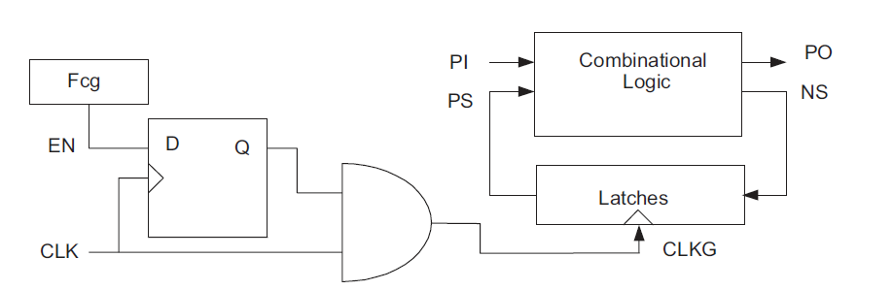
Clock Gated FSM
Fa

Slide 9
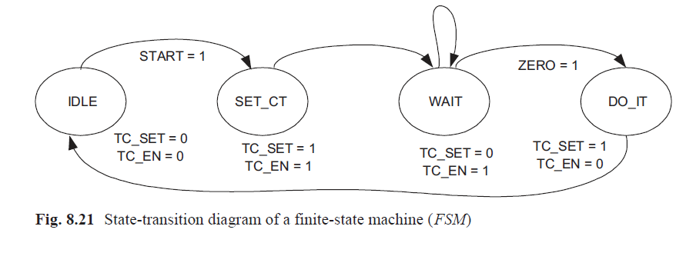
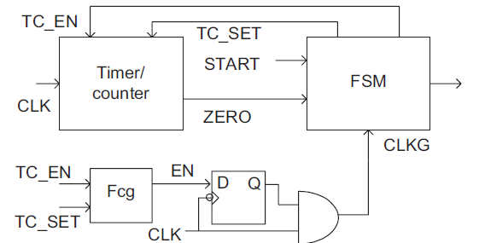

Slide 10

Clock Gated FSM

Slide 11
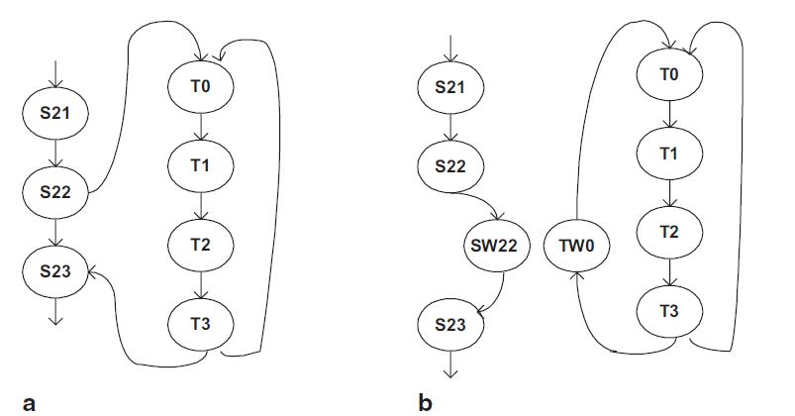
FSM Partitioning

Slide 14
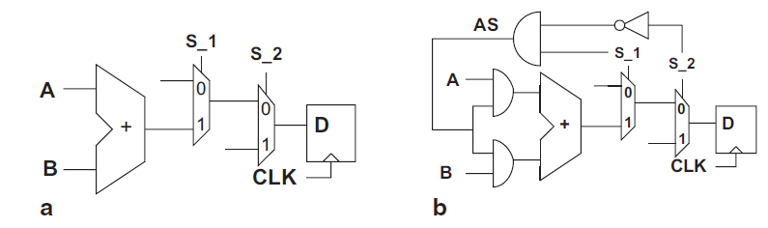
Operand Isolation

Slide 15
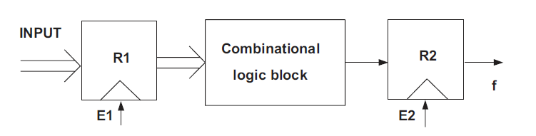
Precomputation

Slide 16
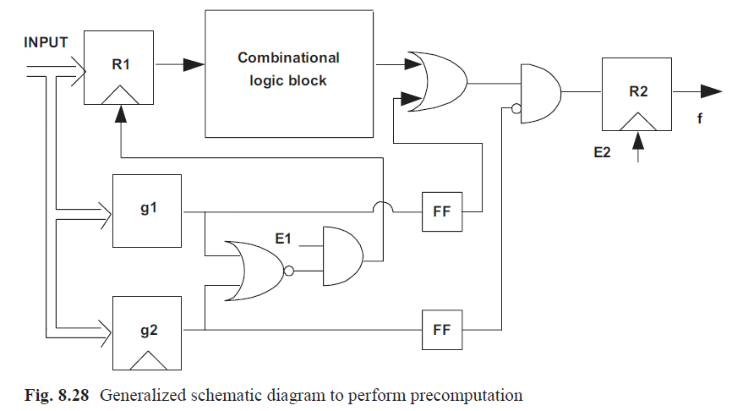

Slide 17
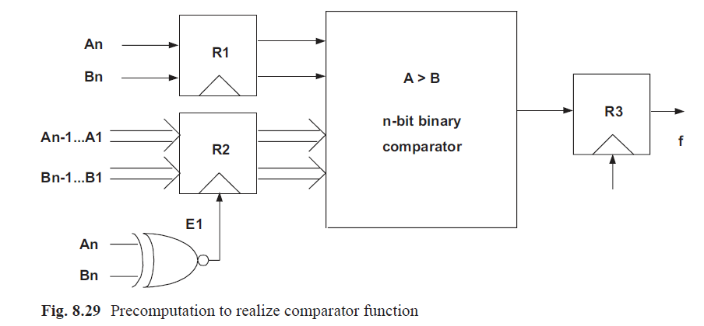
Precomputation

Slide 18
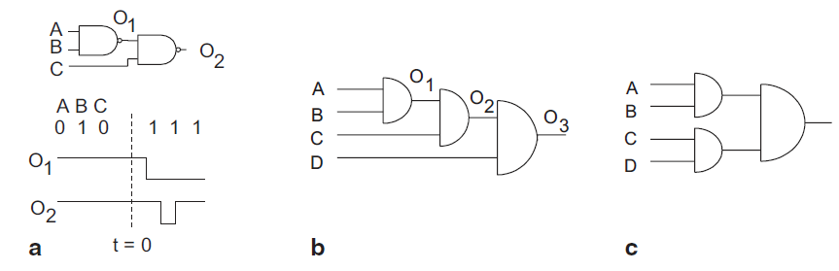
Glitch Power Minimization

Slide 19
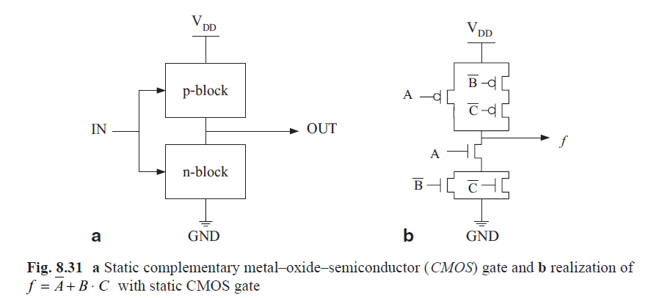
Logic Styles for Low Power

Slide 20
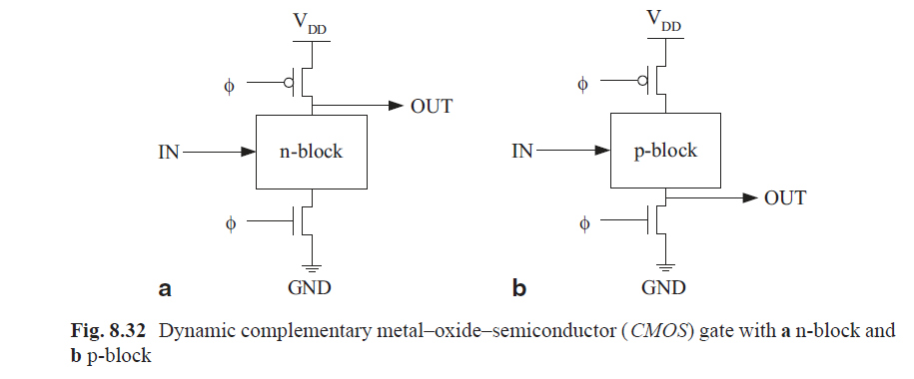

Slide 21
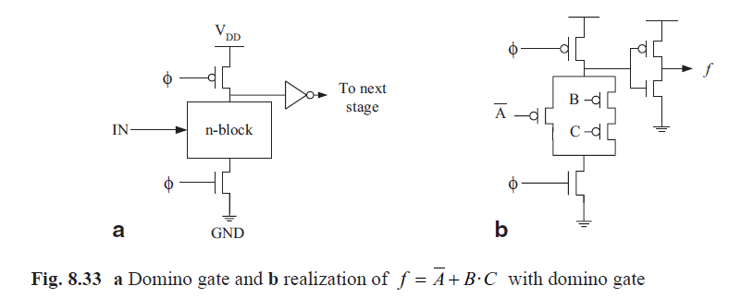

Slide 22
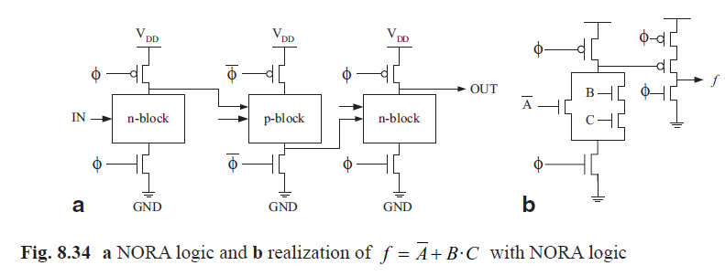

Slide 23
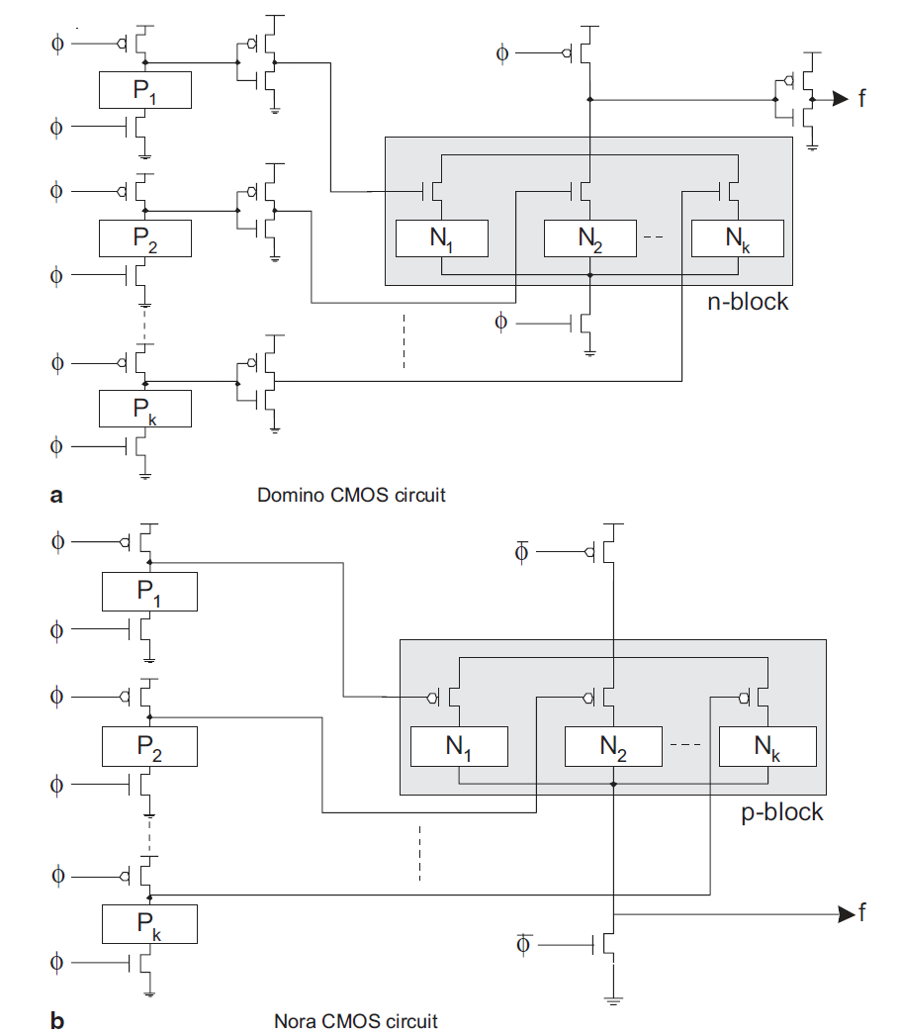

Slide 24
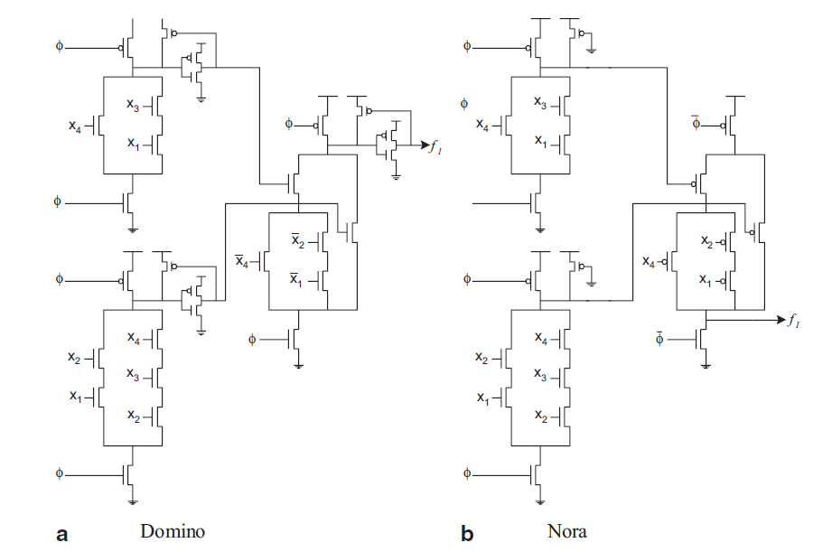

Slide 25
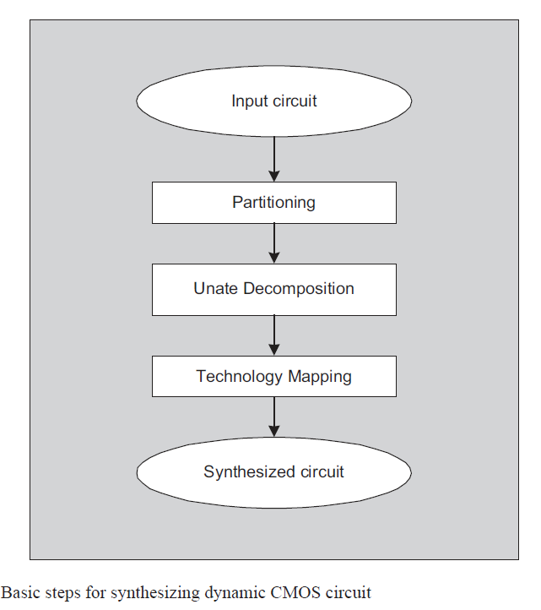

Slide 26
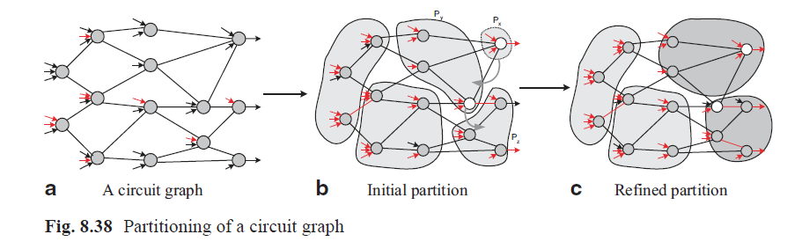

Slide 27
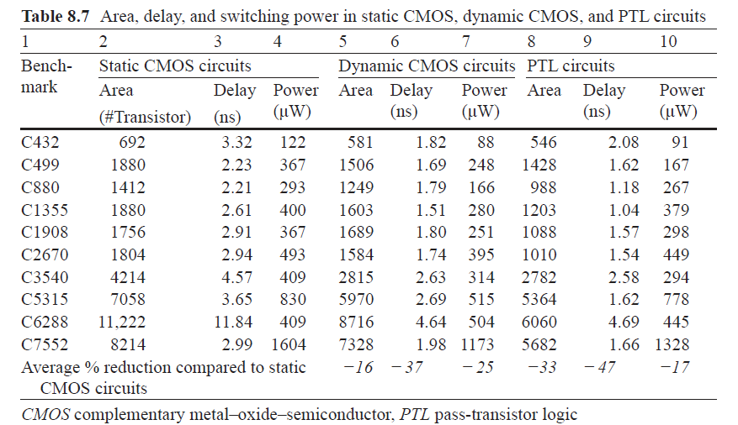

Slide 28
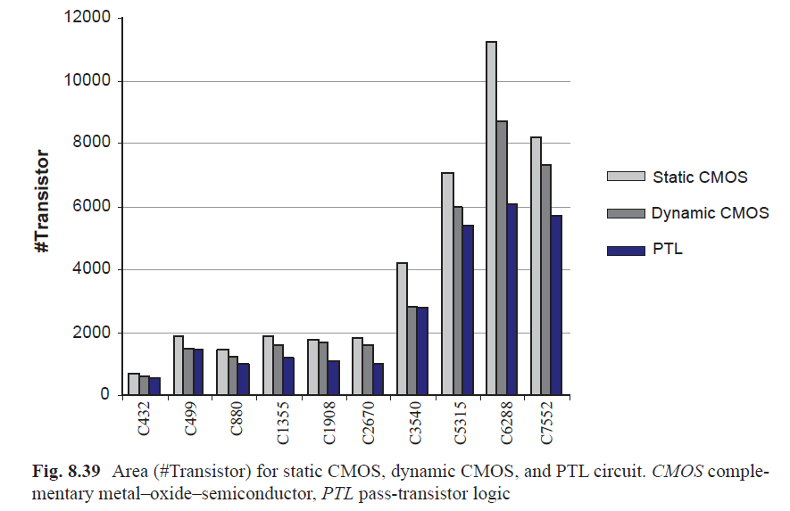

Slide 29
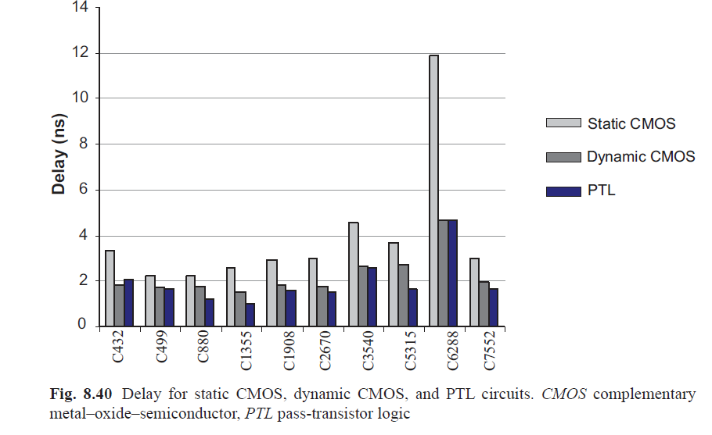

Slide 30
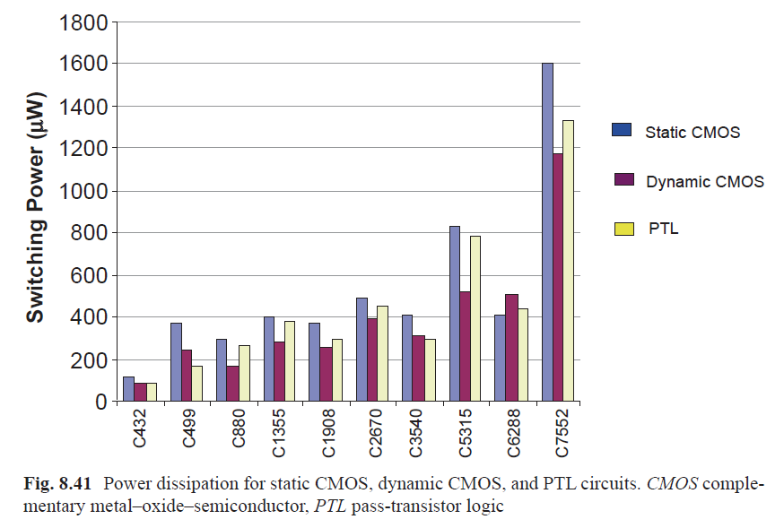

Slide 31
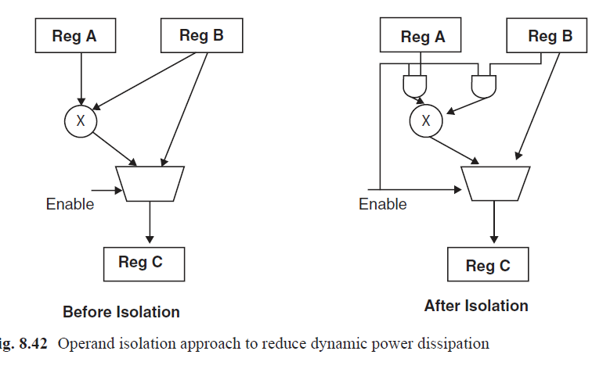

Slide 32
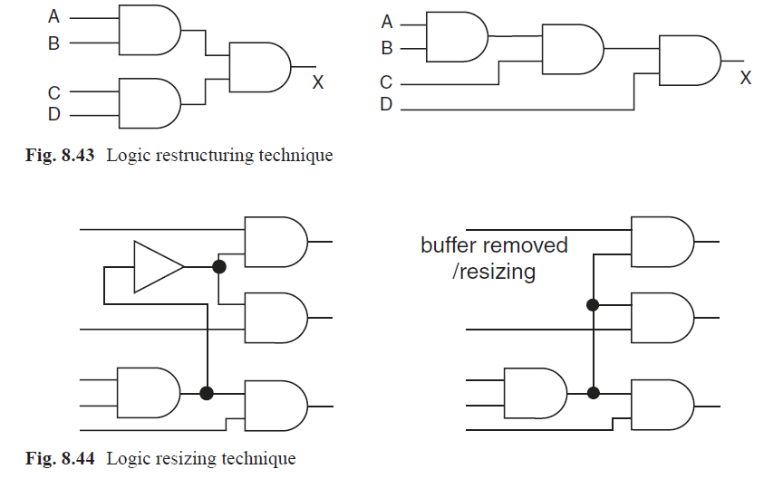

Slide 33
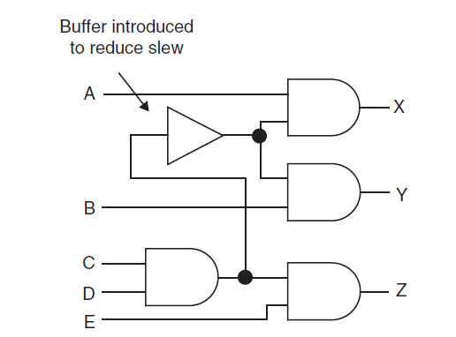

Slide 34
References
Ajit Pal, “Low power VLSI Circuits and Systems” Springer, 2015.

